Slide 1
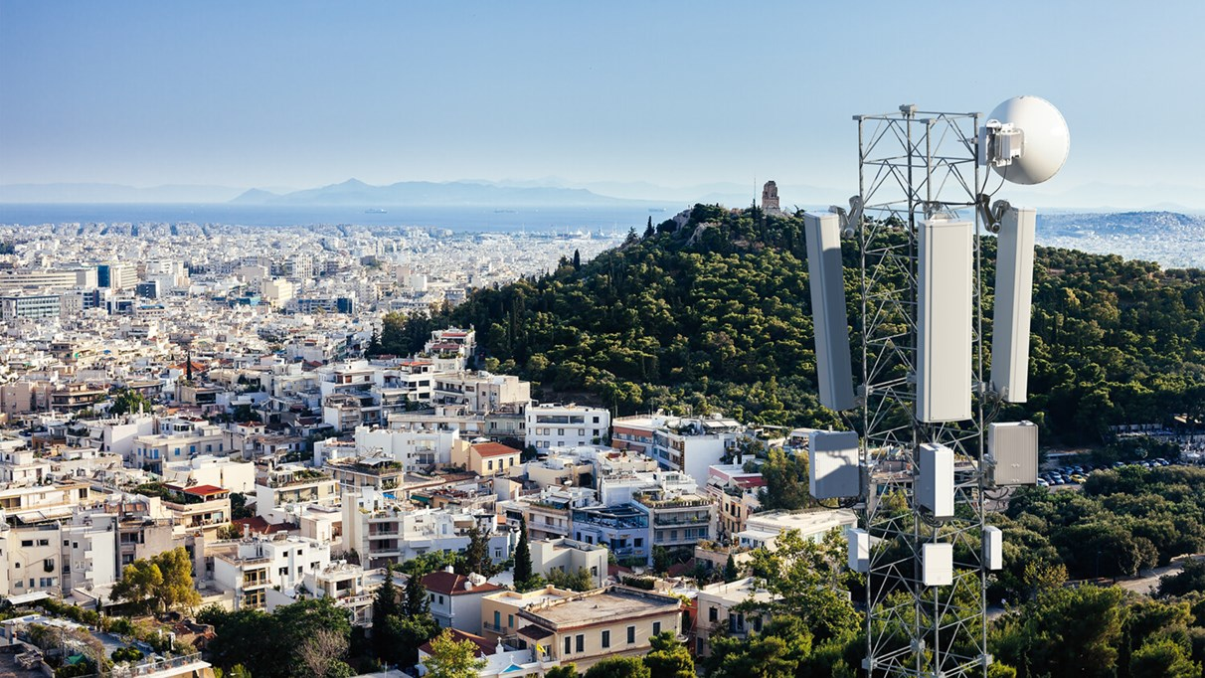
I have to fix connection issues on this tower. But can anyone help me with:
How much energy saved when we use one radio in each sector for two carrier compared to one radio per carrier ?
How much CDMA carrier supported by RBS 6000?
Which type of RBS 6000 radios/RRUS required to support CDMA ?

Slide 2
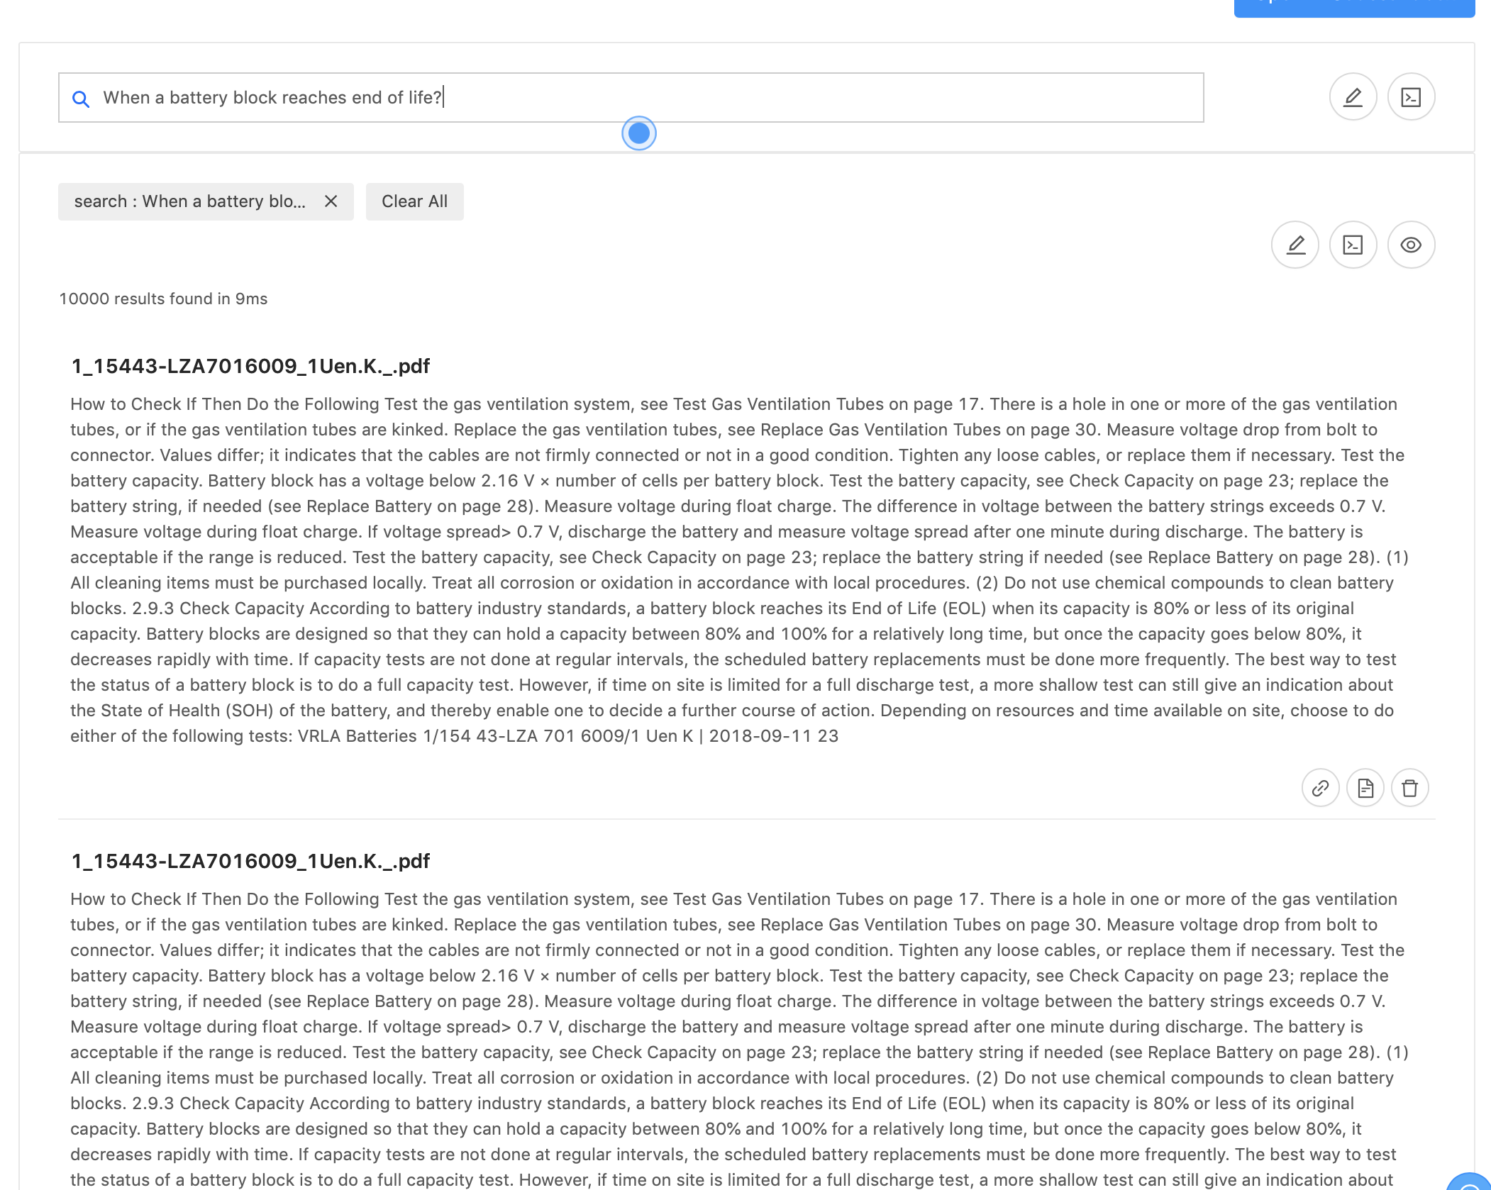
Let me search these questions on portal

Slide 3
It will take so much time to read and get the answers
Wish someone could make it easy !!

Slide 4
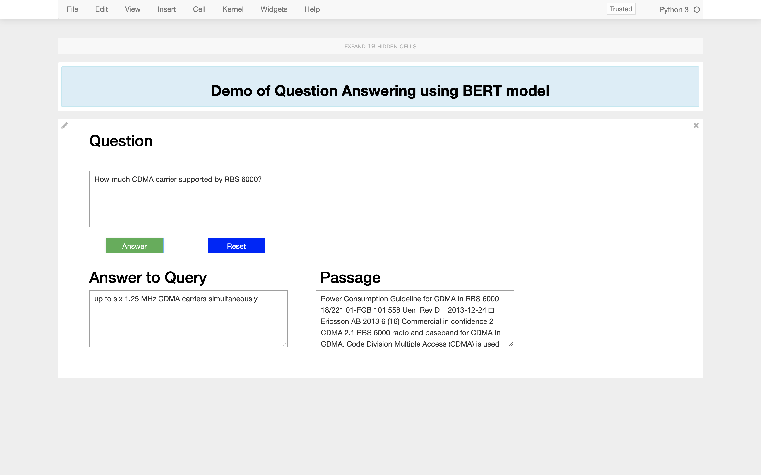

Slide 5
SUPPORT WORKFLOW
Quick Information
Manage Setups
Support
Query Resolution
Field Agents
CS Agent
INTELLIGENT SEARCH

